Slide 1
Lead and Copper Update
Zach Anderson
Lead and Copper Section
Division of Drinking and Groundwater

Slide 2
Agenda
Initial Inventories
  What’s in Ohio
  From now until 2027
Rules Process
  Where we are currently
  Where can you get involved
Final LCRI

Slide 3
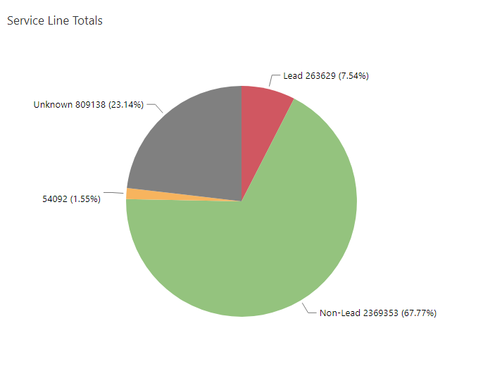
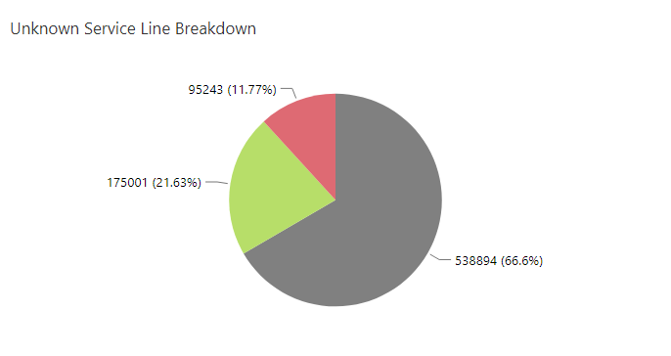
Initial Inventory Data
Totals
  Lead: 263,629
  GRR: 54,092
  Unknown – Likely Lead: 95,243
  Unknown – Material Unk: 538,894
  Unknown – Unlikely Lead: 175,001
  Non–Lead: 2,369,353
Lead, GRR, and Unknown – Likely Lead = 412,964

Slide 4
From Now Until 2027 Baseline Inventory
What is required between now and Nov. 1, 2027
  If you have lead, GRR, or unknown service lines
    Service Line Inventory Material (SLIM) Notifications need to be sent to customers by December 31st, 2025
    SLIM Verification form and updated inventory by January 30th, 2026
Identify service lines
Replace lead and GRR before Nov. 1, 2027
Notes:
Recommend submitting updated inventory
Identify
Unknowns on baseline inventory trigger new requirements
Replace
Lead and GRR trigger similar requirements as unknowns as well as some monitoring changes

Slide 5
Technical Assistance for Service Line Identification
Ohio Rural Community Assistance Program (RCAP)​
  Direct assistance to PWS under 10,000​
  Development of inventory, outreach, assistance with identification​
  Worked with more than 60 communities on their initial inventories​
Local Assistance Providers​
  Ohio EPA contract​
    Service Line Inventory Assistance Program​
    Historical document review, on-site identification, inventory, and replacement plan development​
Notes:
Amy will be covering some of the same programs in her slides
RCAP could be at capacity now but might be worth looking into if you have

Slide 6
Get the Lead Out Ohio
Program created specifically for the state of Ohio​
Aims to educate Ohioans about lead in water and help PWS with LSL replacement​
Documents created to help promote LSL identification and removal efforts in PWS​
Toolkit documents available online for PWS use​
  Three phases​
    Inspect​
      Inform citizens about identifying service lines​
    Treat​
      Inform citizens about how to protect themselves from lead in water​
    Replace​
      Inform citizens about replacing service lines
Notes:
Brief
Just mention toolkit of materials to help with outreach for identifying or replacements

Slide 7
U.S. EPA - Get the Lead Out Initiative
Launched in 2023 as an extension of another lead service line replacement U.S. EPA pilot program​
U.S. EPA (through contractor support) plans to assist up to 200 underserved and disadvantaged communities​
Highlights:​
  LSL Inventories that meet 2021 LCRR requirements/deadline ​
  Community engagement plans that invite community input, provide educational resources, and meaningfully engage affected community members while identifying and replacing LSLs​
  Lead Service Line Replacement Plans to provide each municipality a roadmap for 100% identification and full replacement of all LSL, including public and private portions​
  State Revolving Fund applications to help communities fund their
  service line replacement. Each recipient of this technical assistance
  will receive a customized plan to facilitate their work with the state

Slide 8

State Rules Process
Drafting Rules
Propose Rules to JCARR
Now*
  65-day JCARR jurisdiction
  Comment period
  Public Hearing
State Rule is Effective
Nov. 1, 2027
Federal Rule Published
Oct. 31, 2024
Early Stakeholder Outreach
Interested Party Review
Final Rules
1/30/2025 – 3/1/2025
What is Ohio’s intent?
30-day rule review - typical
Ohio considers comments, produces comment response document
Make adjustments to rules
  Added to OAC - goal sometime in 2026
  Effective date established - 2027
*LCRI is currently on a 60-day abeyance which may delay or change Ohio’s rule making
Notes:
US EPA asked for a 60 day pause ending on July 1
Don’t have guidance from US EPA

Slide 9
Final LCRI
Baseline Inventory
Mandatory Service Line Replacements
Validation of Non-Lead Service Lines
Monitoring Changes
School and Childcare Sampling
New Reporting Requirements
Notes:
Don’t have everything LCRI in the presentation like CC

Slide 10
Baseline Inventory
Will be due November 1, 2027
Connector material will be required on the inventory
Only needs to be a records review
Street address will be required
Already a requirement in Ohio
Annual updates of the inventory
Only if you have LSL, GRR, or Unknown –
1st update due
Jan. 30, 2029
Ohio EPA discussing making mandatory
‘Basis of Material Classification’
  Will be necessary for validation
Was ‘Material Ever Previously Lead’
  Required to determine to verify if galvanized service line is GRR
Notes:
Mention replacing connectors
Replace connectors
14 month for first program year

Slide 11
Mandatory Service Line Replacements
November 1, 2027
2027-2037
December 31st, 2037
Service Line Replacement Plan due for any PWS with LSL, GRR, or Unknown
Required LSLR Plan Info
  Strategy for determining material composition of unknowns
  SOP for conducting full LSL replacement
  Communication strategy to inform customers
  Strategy to prioritize replacements
  Funding strategy
  Control of service line
  Etc
Start replacing service lines
Shorter replacement deadlines can be imposed by state
Only full-service line replacements count
If an Unknown is revealed for replacement and it is copper, for example, it doesn’t count as a replacement
At least 4 attempts need to be made to replace customer’s LSL
Systems must replace their side when customer replaces their LSL
All LSL and GRR replaced
No Unknowns on inventory
Notes:
Publicly accessible
10% cumulative average
Template for lslr plans coming

Slide 12
Validation of Non-Lead Service Lines
In LCRI 141.84(b)(5)(ii)
Installed after state LSL ban date,
2-point physical verification, or recently replaced do not require validation
The validation pool will be made up of the remaining non-lead service lines
Will require at least 2 points of physical verification
  One on private and one on public
  If a system can’t get permission to physically verify the service line, it will need to replace it with another randomly selected site
Size of Validation Pool | Number of Validations Required
<1,500 | 20% of validation pool
1,500 to 2,000 | 322
2,001 to 3,000 | 341
3,001 to 4,000 | 351
4,001 to 6,000 | 361
6,001 to 10,000 | 371
10,001 to 50,000 | 381
>50,000 | 384
Notes:
7 year deadline

Slide 13
SMP Tiering Change
Tier 1
Single-family structure with LSL
Tier 2
Building or multifamily residence with LSL
Tier 3
Single family structure with GRR or lead connector
Tier 4
Single family structure with copper pipes and lead solder before state ban
Tier 5
Site representative of the distribution

Slide 14
AL and Sample Monitoring Changes
Still requires all samples to be collected from sites served by LSLs
1st and 5th liter sampling at homes served by LSL
  Highest value will be counted for compliance
Any system with LSL or GRR service line on Baseline Inventory will go back to standard monitoring for at least TWO monitoring periods
Annual monitoring will be standard sample collection for lead and reduced for copper
Trigger level has been removed from the rule
New Lead Action Level is 10 ug/L
LSL replacement no longer triggered by an ALE
24-hour Tier 1 PN for ALE

Slide 15
School and Childcare Sampling
Public Water Systems (PWSs) with schools or childcare facilities that were built before 01/01/2014 and have a lead, GRR, or unknown service line.
Must sample 20% of elementary schools and 20% of childcare facilities served by the PWS every year until all schools and childcare facilities have been sampled or have declined
  No school/childcare facility is required to be sampled more than once every 5 years
  After the 5-year period, school/childcare facilities only need to be sampled upon request
Secondary schools must be sampled upon request
PWSs must compile a list of all schools and childcare facilities they serve
  At least once every 5 years, PWSs must submit either an updated list of their schools and childcare facilities or a confirmation that there have been no changes

Slide 16
School and Childcare Sampling
Schools
Collect 5 samples from an outlet usually used for consumption - no point of use (POU) devices should be used at these locations unless all taps have POUs
Ideal sampling locations, where possible, include:
Childcare Facilities
Collect 2 samples from outlets usually used for consumption
Sampling locations must include 1 drinking fountain and 1 of the following:
2 drinking fountains
1 kitchen faucet (used for food or drink preparation)
1 classroom faucet
1 faucet in the nurse’s office
Kitchen faucet where food or drinks are prepared
Classroom faucet
Another outlet used for drinking
Notes:
Mention reporting requirements

Slide 17






General Questions DDAGWLeadCopper@epa.ohio.gov
Heather Jackson, Manager
614.644.2767
Heather.Jackson@epa.ohio.gov
Zachary Anderson, Supervisor
614.644.4902
Zachary.Anderson@epa.ohio.gov
Jodi Elam, Lead & Copper Compliance Coordinator
614.369.3817
Jodi.Elam@epa.ohio.gov
Alexandra Haritos, Lead & Copper Compliance
614.644.2915
Alexandra.Haritos@epa.ohio.gov
Thank
You
Follow Ohio EPA on

